Slide 1
NODE.JS
(The Backend Of MERN Stack)
Lecture 38

Slide 2
Today’s Agenda
Using Query Object
Query Helpers
Projection With Query
Sorting With Query
Using findOne()
Using findById()

Slide 3
What is query object ?
Many Mongoose model functions, like find(), return a Query object.
The Query object provides a many helper methods for performing operations on documents.

Slide 4
Using helper methods
The Query object provides us a method called where() which can accept a field name as argument.
Then on return value of where() we can chain various methods like eq(), lt(), gt(), in() etc to get back the desired result.

Slide 5
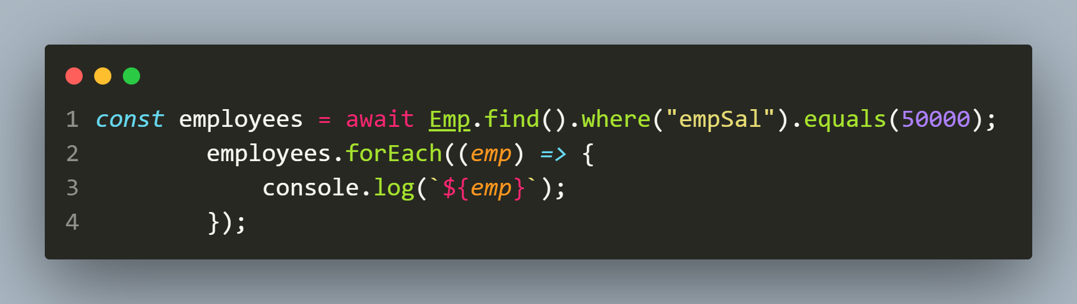
Example 1
Fetching records of all employees who earn 50000
CODE:
OUTPUT:

Slide 6
List of useful helpers
Method | Purpose
lt(value), gt(value) | specify that a property must be < or > a value
lte(value), gte(value) | specify that a property must be <= or >= a value
in(arr) | specify that a property must be equal to one of the values specified in arr
nin(arr) | specify that a property must not equal any of the values specified in arr
eq(value) | specify that a property must be equal to val
ne(value) | specify that a property must not be equal to val

Slide 7
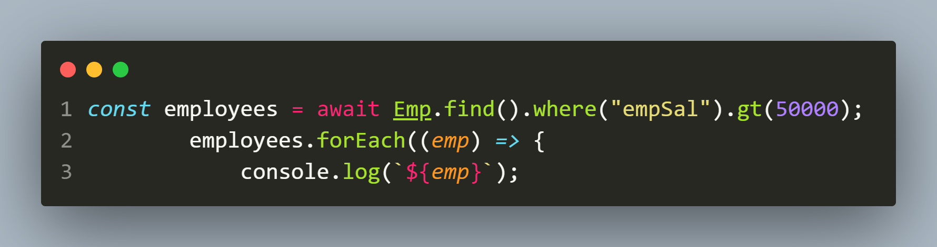

Example 2
Fetching records of all employees who earn more than 50000
CODE:
OUTPUT:

Slide 8
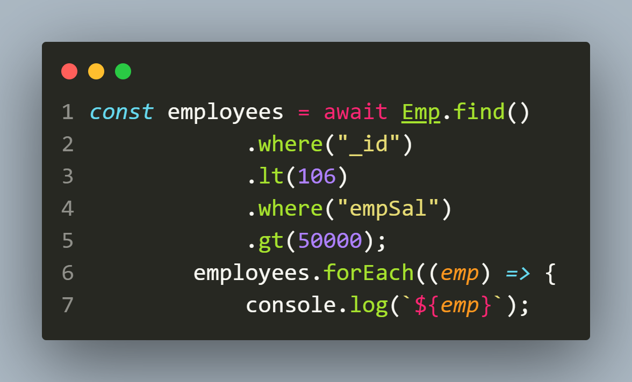
Example 3
Fetching records of all employees who have _id less than 106 and they more than 50000
CODE:
OUTPUT:

Slide 9
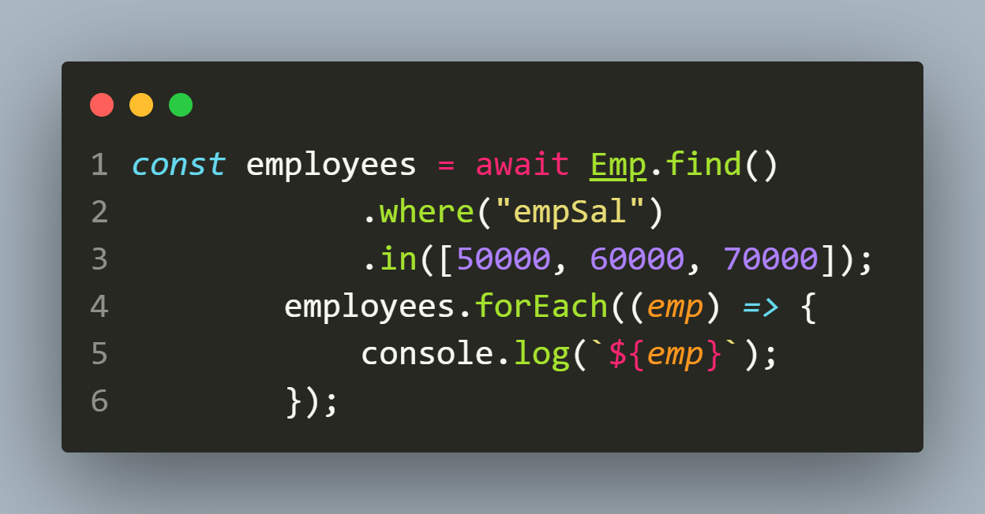

Example 4
Fetching records of all employees who earn 50000,60000 or 70000
CODE:
OUTPUT:

Slide 10
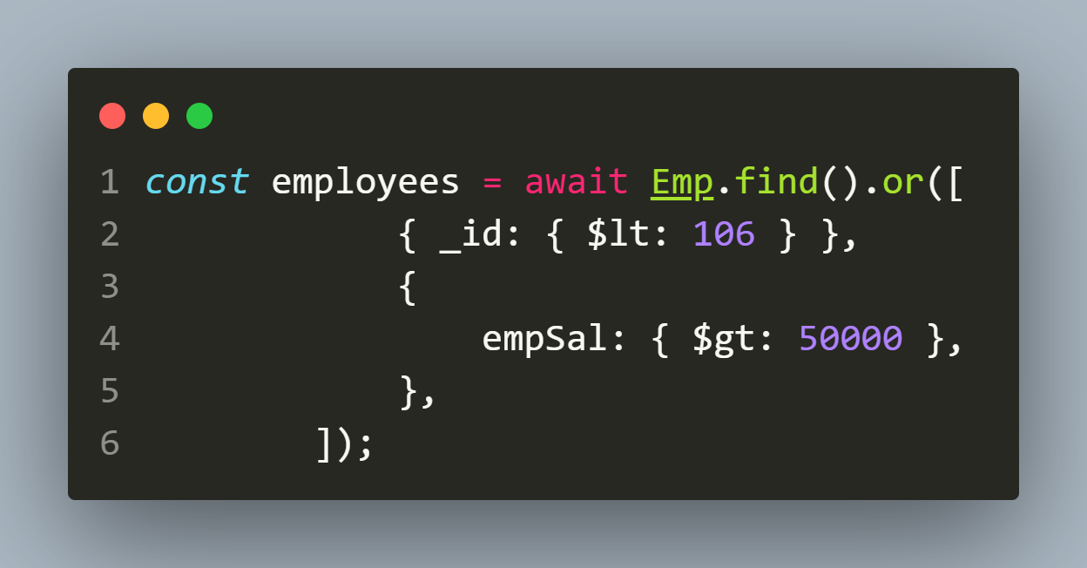
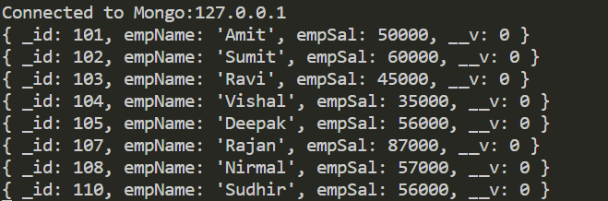
Example 5
Fetching records of all employees who either have _id less than 106 or they more than 50000
CODE:
OUTPUT:

Slide 11
Projection with query object
The Query object has a method called select() that is used to select document fields that are to be returned in the query result.
Syntax:
<Query_obj>.select(<String><object><Array of Strings>)
It is used to include or exclude document fields that are returned from a Mongoose query.

Slide 12
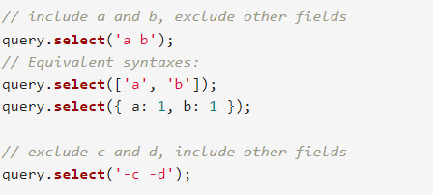
Projection with query object
This can either be done using string syntax or we can use object syntax.

Slide 13
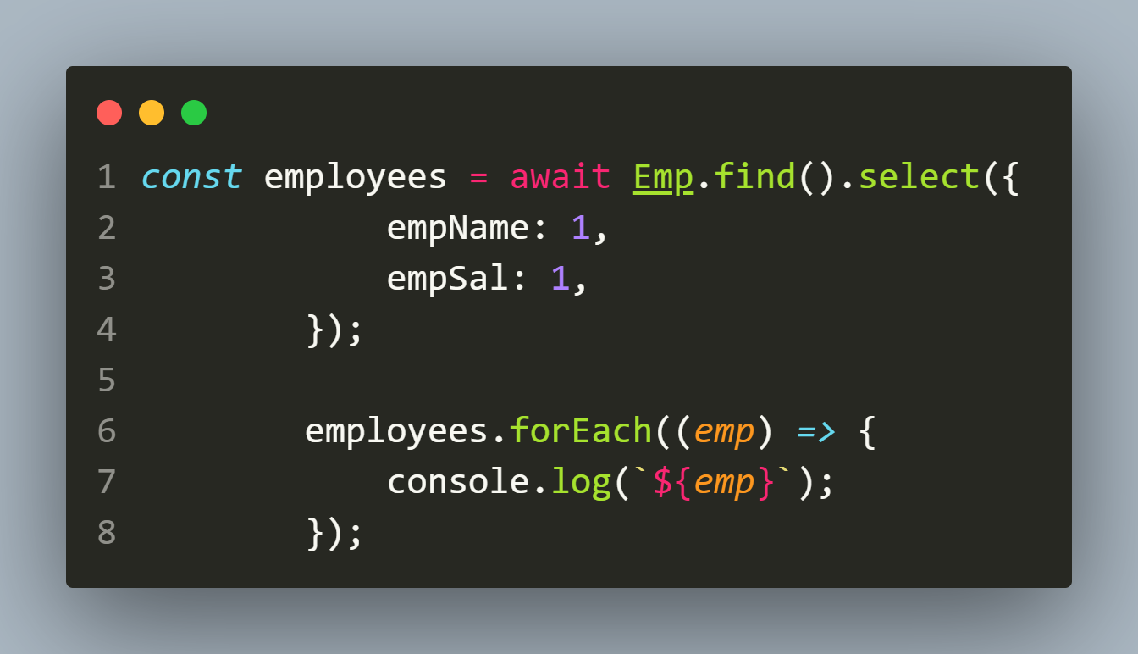
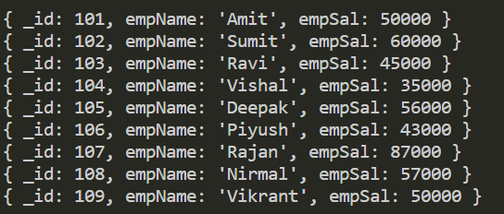
Example 6
Display the name and salary of all the employees.
CODE:
OUTPUT:

Slide 14
Sorting using query object
The Query object has a method called sort() that is used to sort the documents based on one or multiple fields
Syntax:
<Query_obj>.sort(<object>)
We pass the fieldnames along with ‘asc’ or ‘desc’ or 1 or -1 to indicate sorting in ascending or descending order.

Slide 15
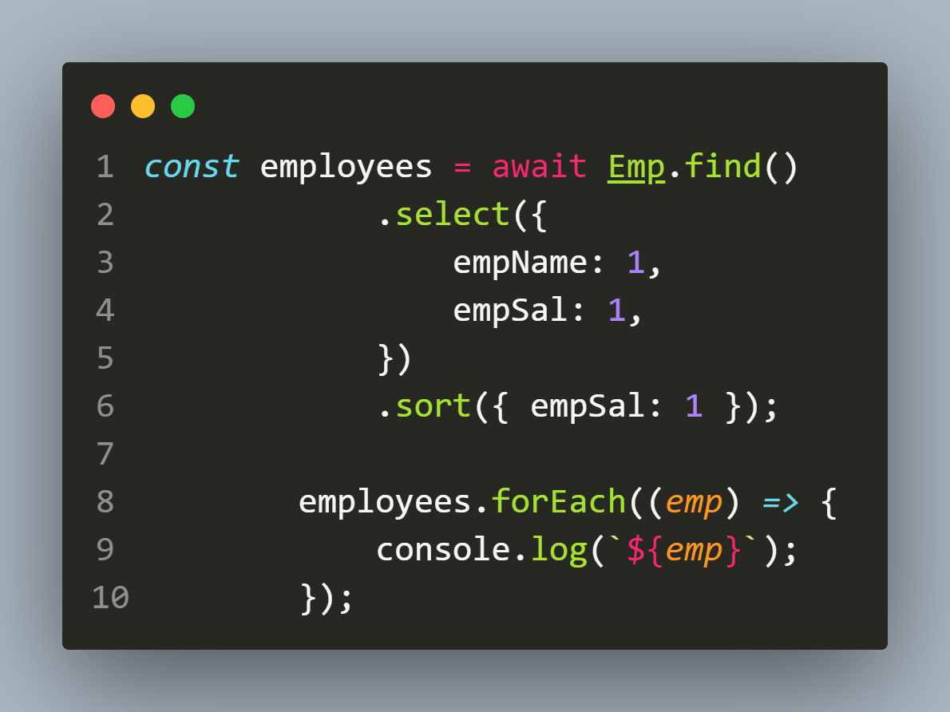
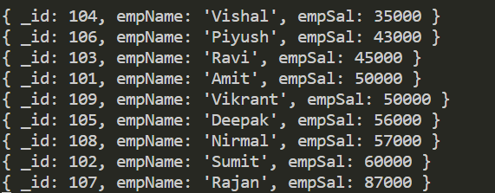
Example 6
Display the name and salary of in ascending order of salary.
CODE:
OUTPUT:

Slide 16
limiting using query object
The Query object has a method called limit() that is used to limit the number of documents the query will return.
Syntax:
<Query_obj>.limit(<number>)
The numeric value passed as argument specifies the maximum number of documents the query will return.

Slide 17
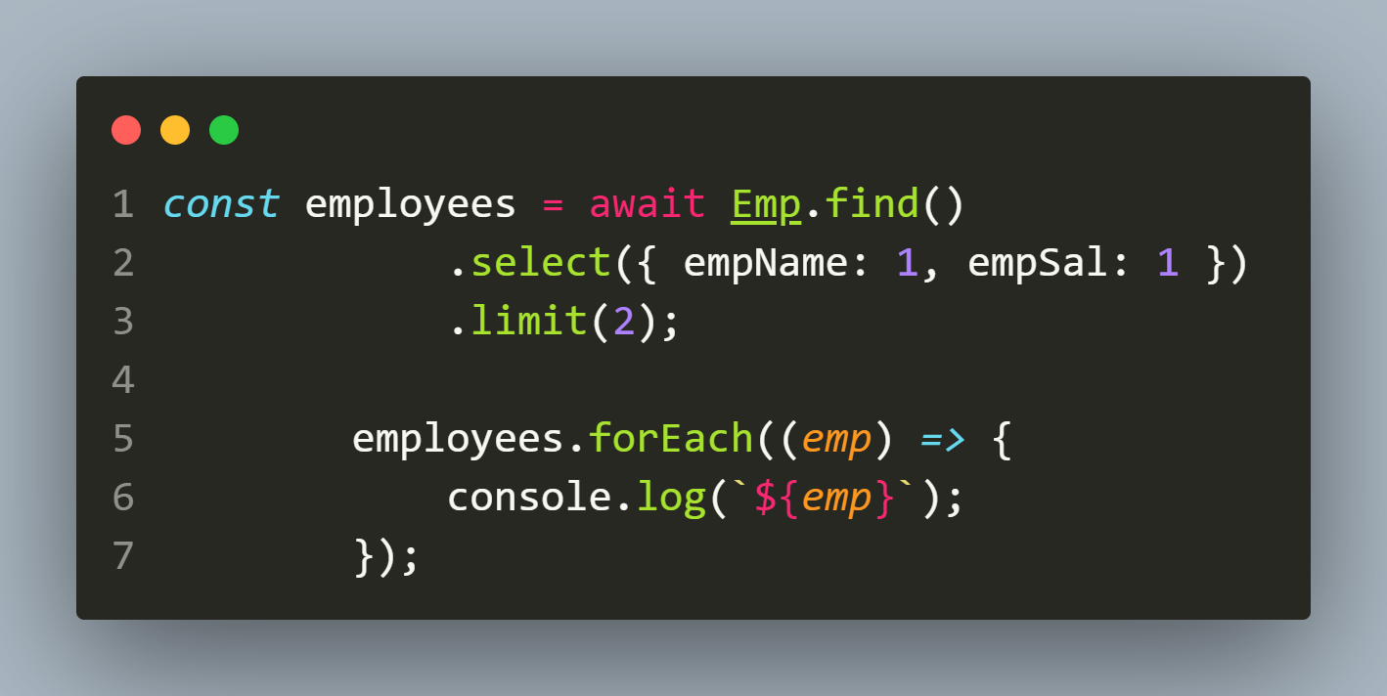

Example 7
Display the name and salary of only first two employees.
CODE:
OUTPUT:

Slide 18
Using findOne()
The findOne() method belongs to Model constructor and is used to find one document according to the condition.
If multiple documents are matching the condition, then it returns the first document satisfying the condition.
Syntax:
Model.findOne({filter},{projection},{options})
filter: Represents the filter object . MongoDB will search for first document that matches the filter.
projection: A string or object representing fields to be returned
options: An object representing query options

Slide 19
What does findOne() return ?
Just like the find() method , the findOne() method also returns a Query object.
In case we want Promise object then we can call the exec() method of Query object.

Slide 20
Exercise 72
Write an Node-Mongoose application to connect to the MongoDB database and fetch and display the first employee whose salary is 50000 from the emps collection

Slide 21
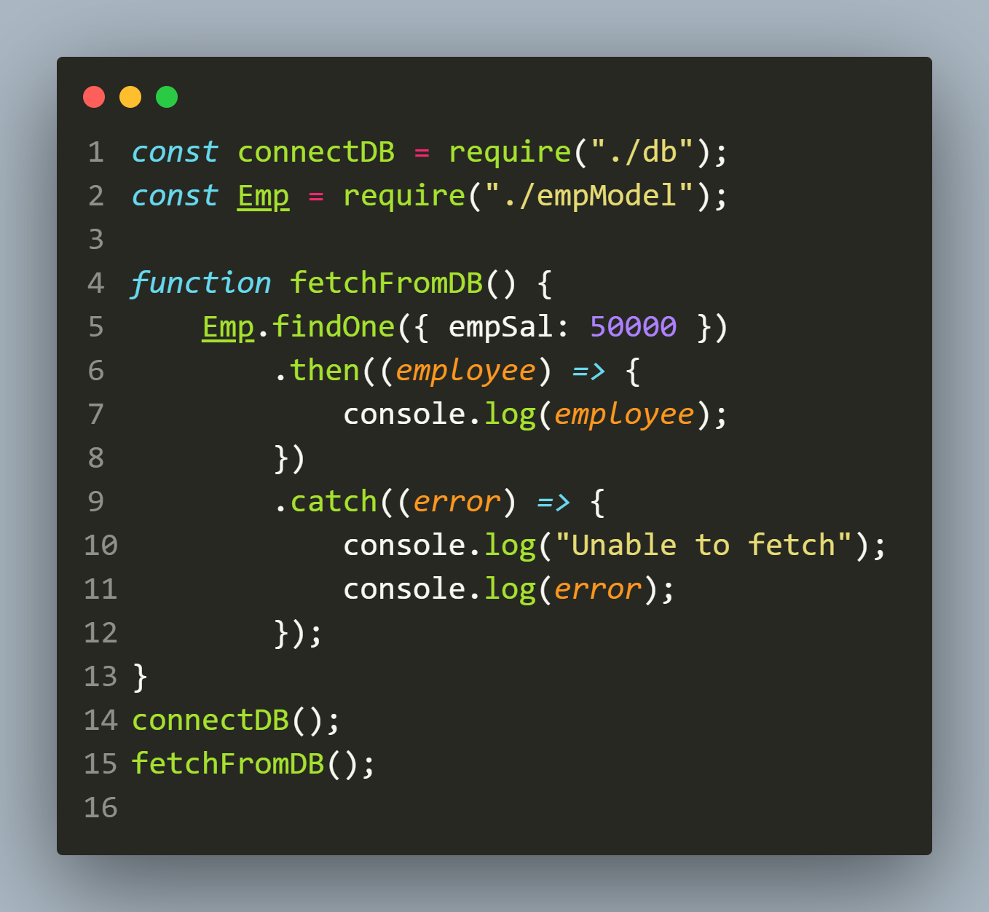
Solution(app.js)

Slide 22
output

Slide 23
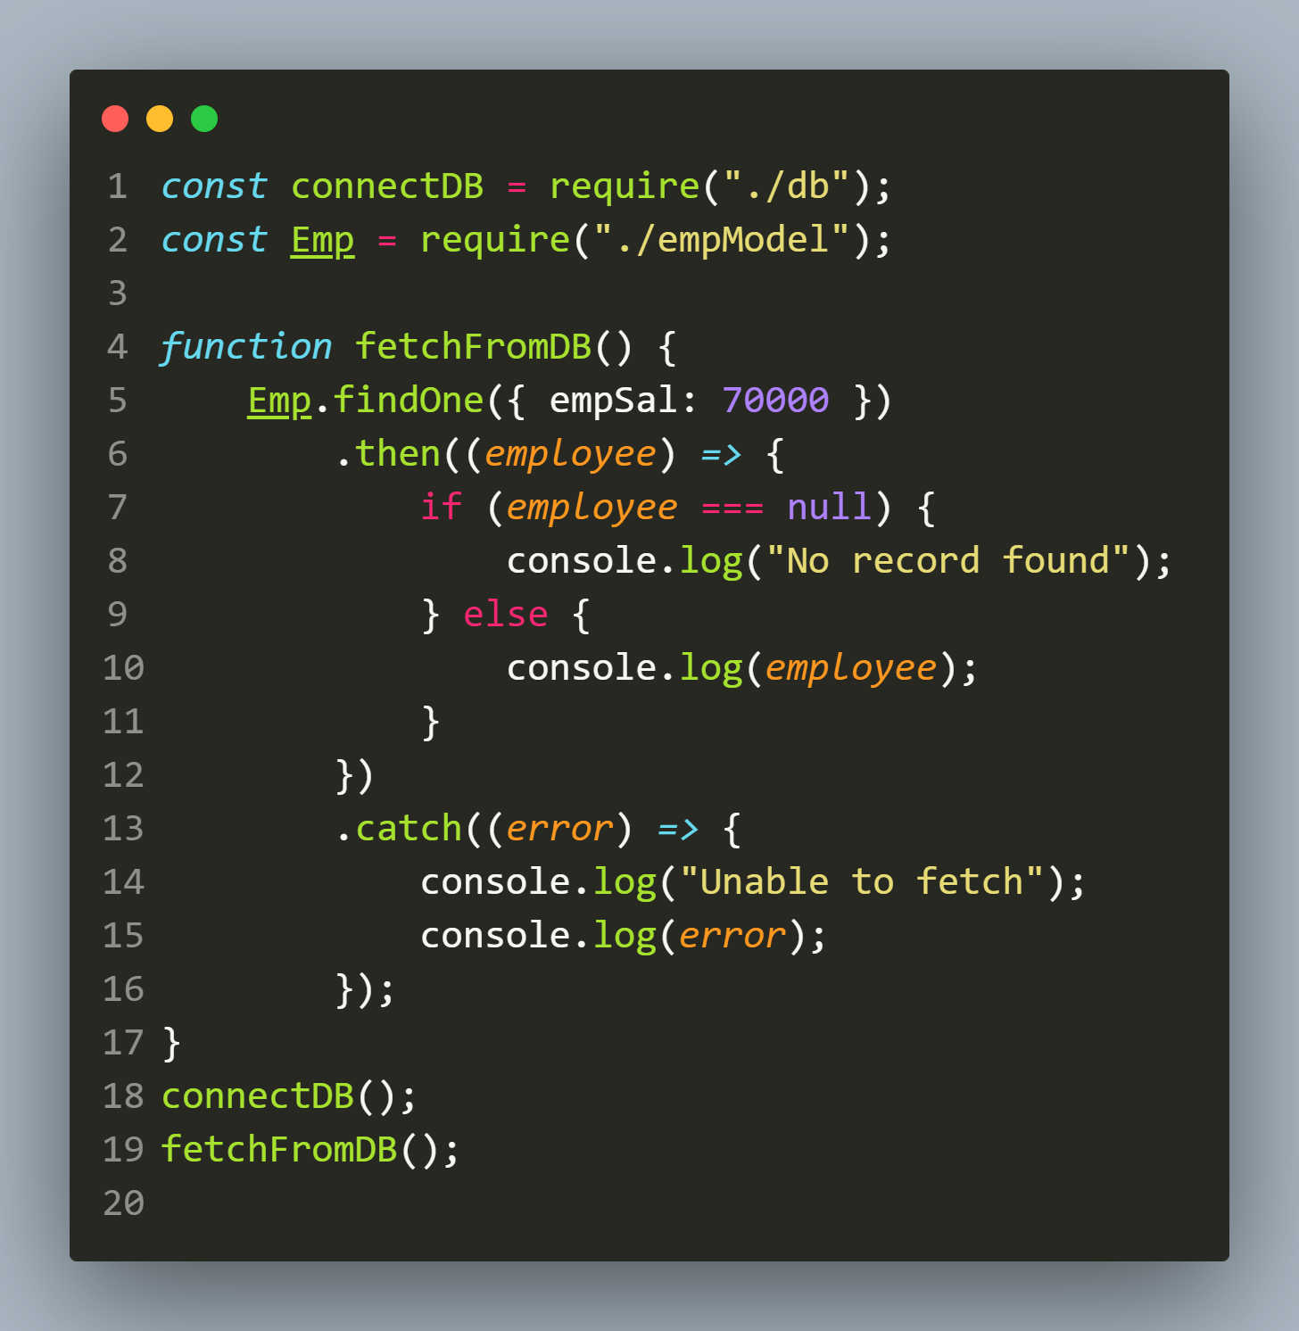
What if criteria fails ?
When we use then()/catch() with findOne() and the criteria fails then we get a null object.

Slide 24
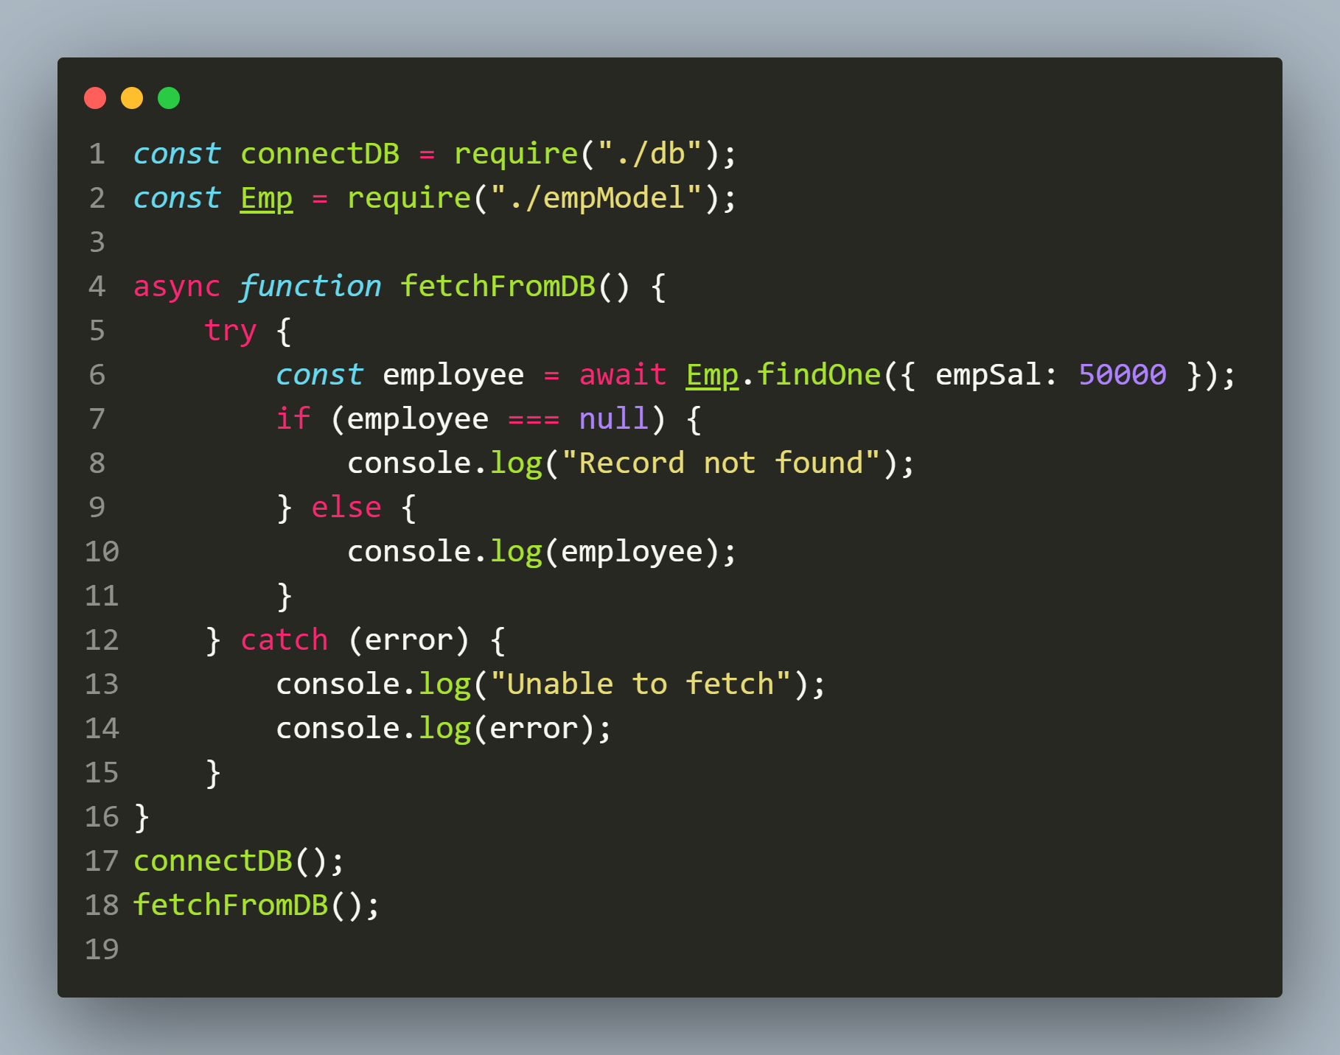
Using async-await with findOne()

Slide 25
Using findById()
The findById() method belongs to Model constructor and is used to find a document according to the _id field value.
When we call findById(_id), then Mongoose internally calls findOne({ _id })
Syntax:
Model.findById(id,{projection},{options})
id: Any value of the field _id.
projection: A string or object representing fields to be returned
options: An object representing query options

Slide 26
What does findById() return ?
The findById() method also returns a Query object.
When the Query object gets resolved , we either get a Mongoose document or null if there is no document with matching id.

Slide 27
Exercise 73
Write an Node-Mongoose application to connect to the MongoDB database and fetch and display the first employee with id as 105 from the emps collection.

Slide 28
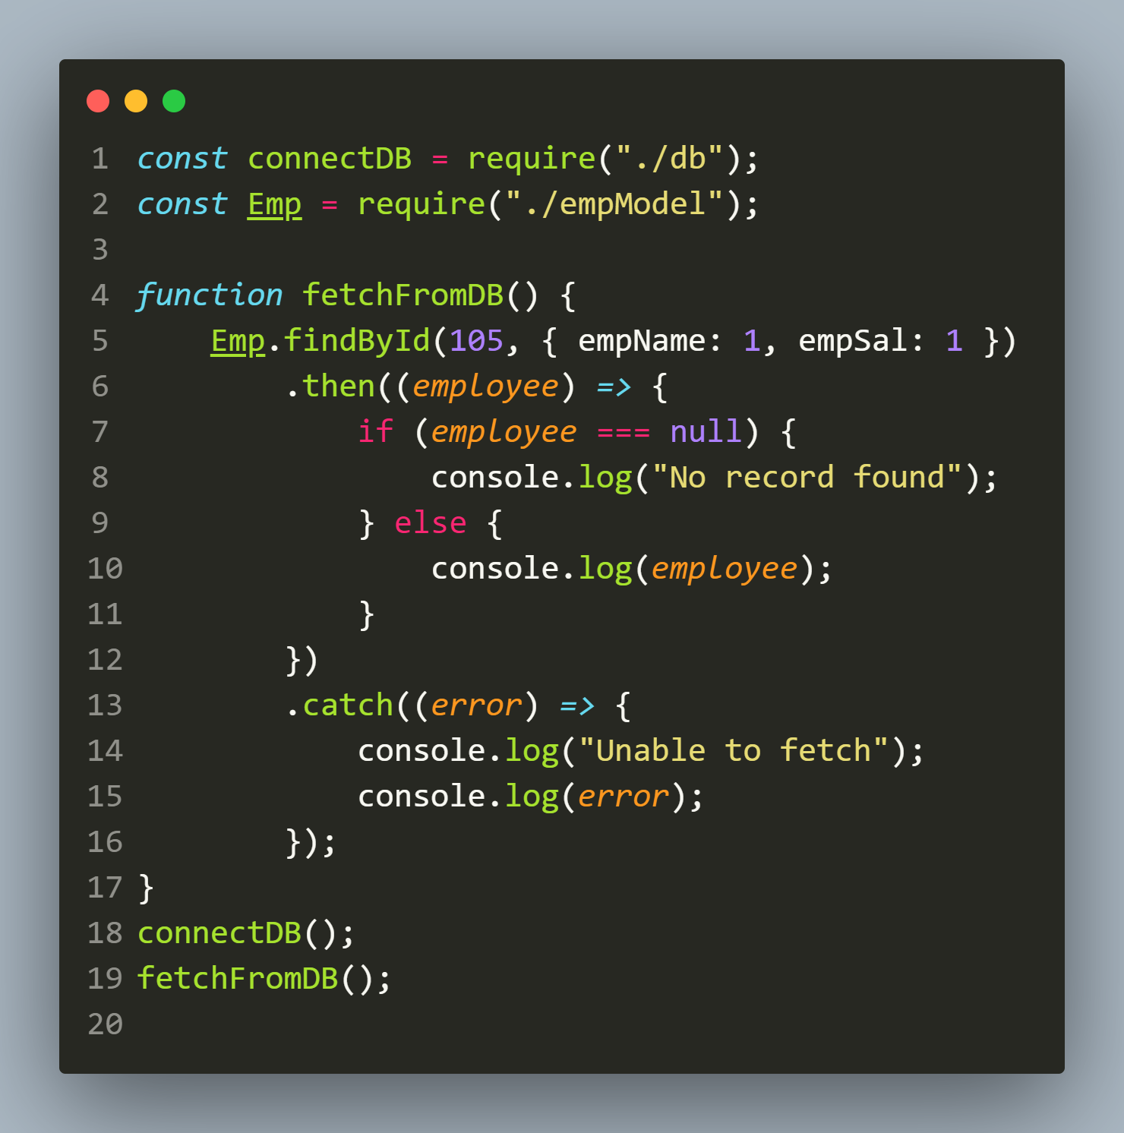
Solution(app.js)

